Slide 1



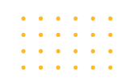
Support Vector Machine

Slide 2

Objective & Outline
Page 01

Slide 3
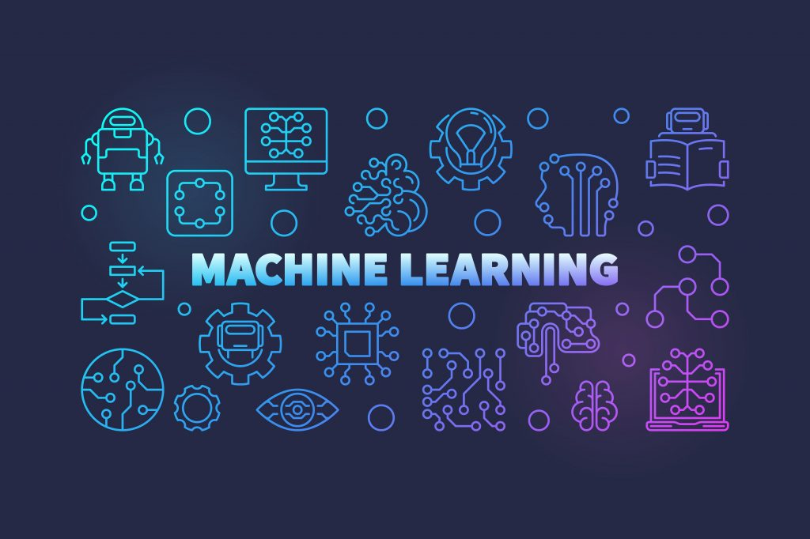
Objective & Outline
Objective
Understanding one of the top five supervised machine learning algorithms which is Support Vector Machine (SVM) algorithm.
Outline
Overview the history of SVM
SVM Concept
Application of SVM
Page 02

Slide 4
Overview the history of SVM
Page 03

Slide 5

Overview the history of SVM
Developed at AT&T Bell Laboratories by Vladimir Vapnik with colleagues first introduced in 1992 at the Annual Workshop on Computational Learning Theory which is rooted in statistical principles, optimization, and machine learning.
The popularity of SVM outperformed ANN's popularity in the 90s.
SVM is known as the Neural Network in the 90s because it can cover regression and classification problems at the same time.
Page 04

Slide 6
SVM algorithm
Page 05

Slide 7
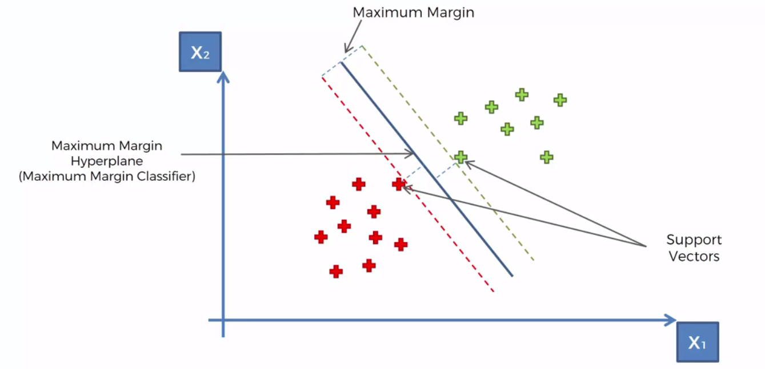
SVM Algorithm (Concept)
Top 5 supervised algorithms
Can be used for Classification & Regression problems
Can generalize linear & nonlinear model
Names in scikit-learn:
SVC (SVM Classifier)
SVR (SVM Regressor)
Page 06

Slide 8
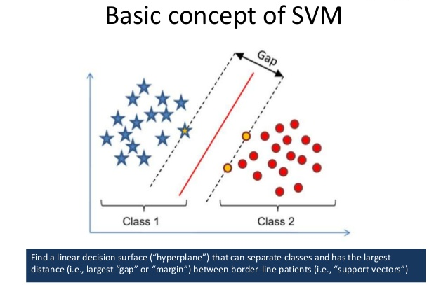
SVM Algorithm (Concept)
Find solution (hyperplane) with fewest errors
Maximize margin separator to improve generalization
Page 07

Slide 9
SVM Algorithm (Concept)
What is Support Vector?
The borderline data points that is “supporting” the construction of the hyperplane
More support vectors doesn’t mean better
What is Margin?
(Perpendicular) gap between classes
Higher margin = better separating hyperplane
Page 08

Slide 10
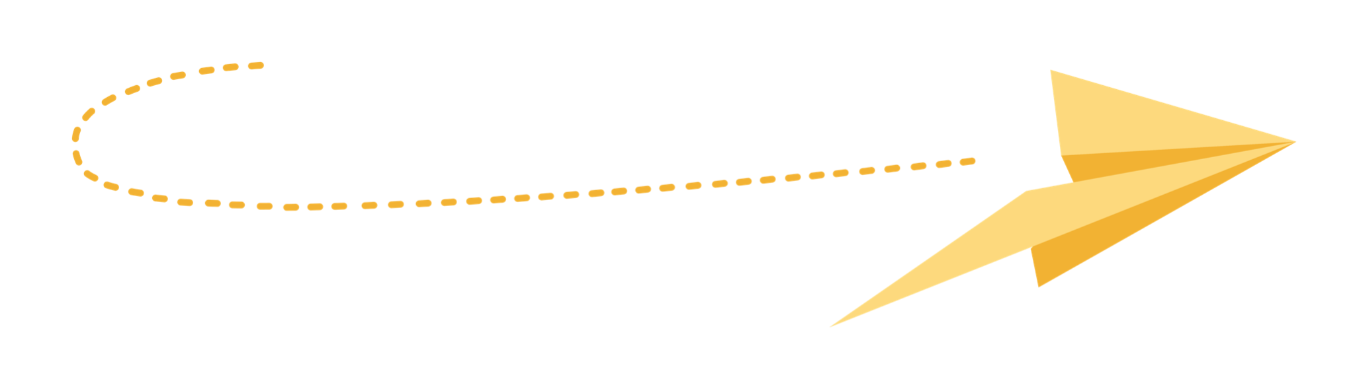
Quiz Session
Page 09

Slide 11
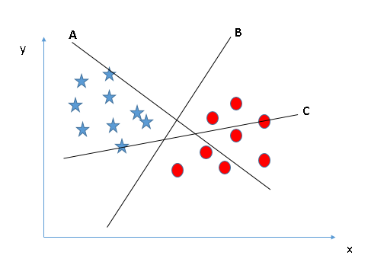
Quiz
Which line is the best SVM?
Scenario 1
Page 10

Slide 12
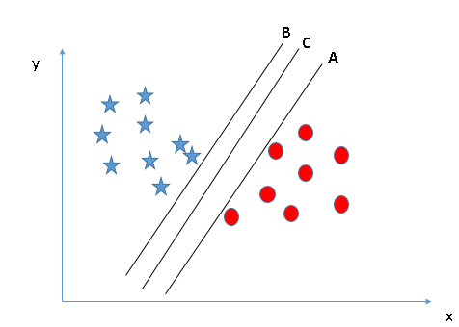
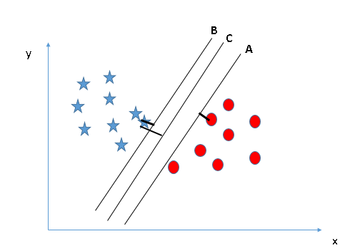
Quiz
Which line is the best SVM?
Scenario 2
Page 11

Slide 13
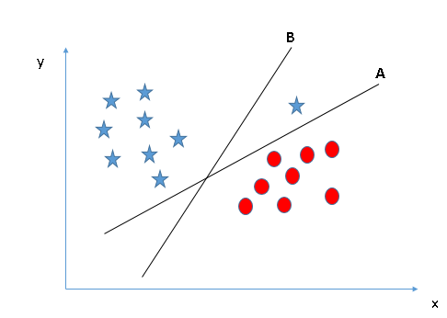
Quiz
Which line is the best SVM?
Scenario 3
Page 12

Slide 14
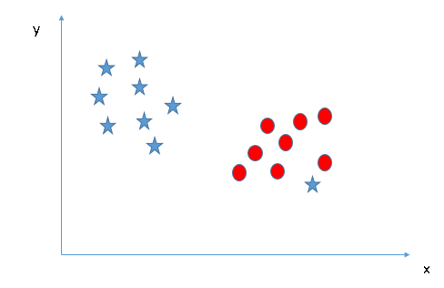
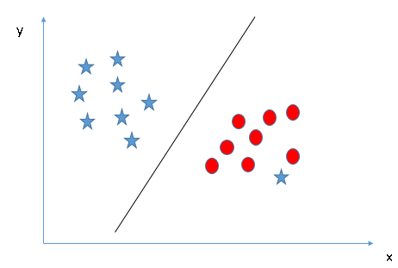
Quiz
Which line is the best SVM?
Scenario 4
Page 13

Slide 15
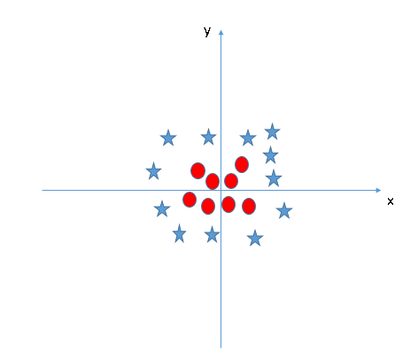
Quiz
Which line is the best SVM?
Scenario 5
Page 14

Slide 16
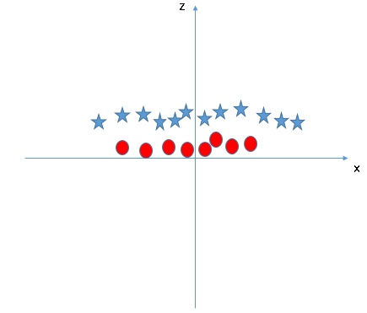
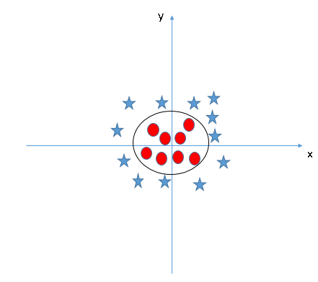
Quiz
Which line is the best SVM?
Scenario 5
Page 15

Slide 17
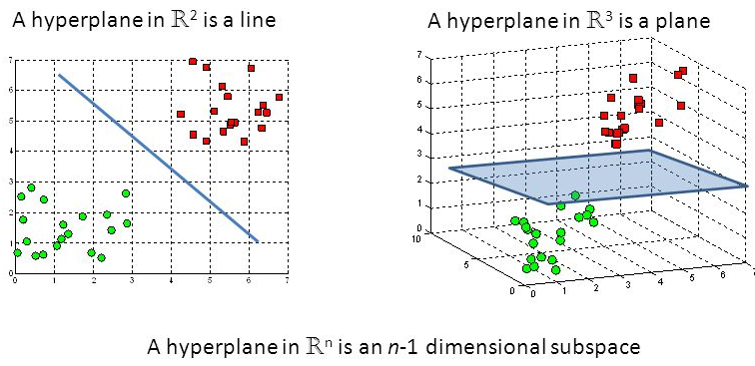
SVM Algorithm (Concept)
What is Decision Surface?
Hyperplane is a linear decision surface that splits the space into two parts
Hyperplane is a binary classifier
Page 16

Slide 18
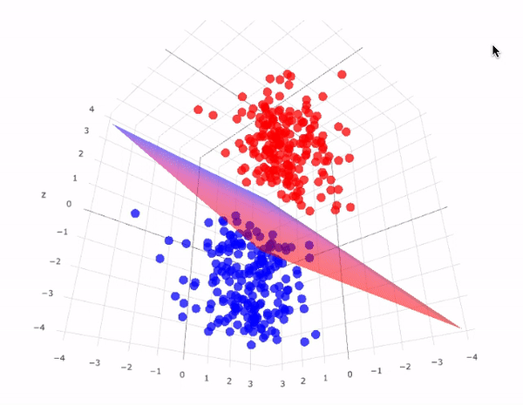
SVM Algorithm (Concept)
Page 17

Slide 19
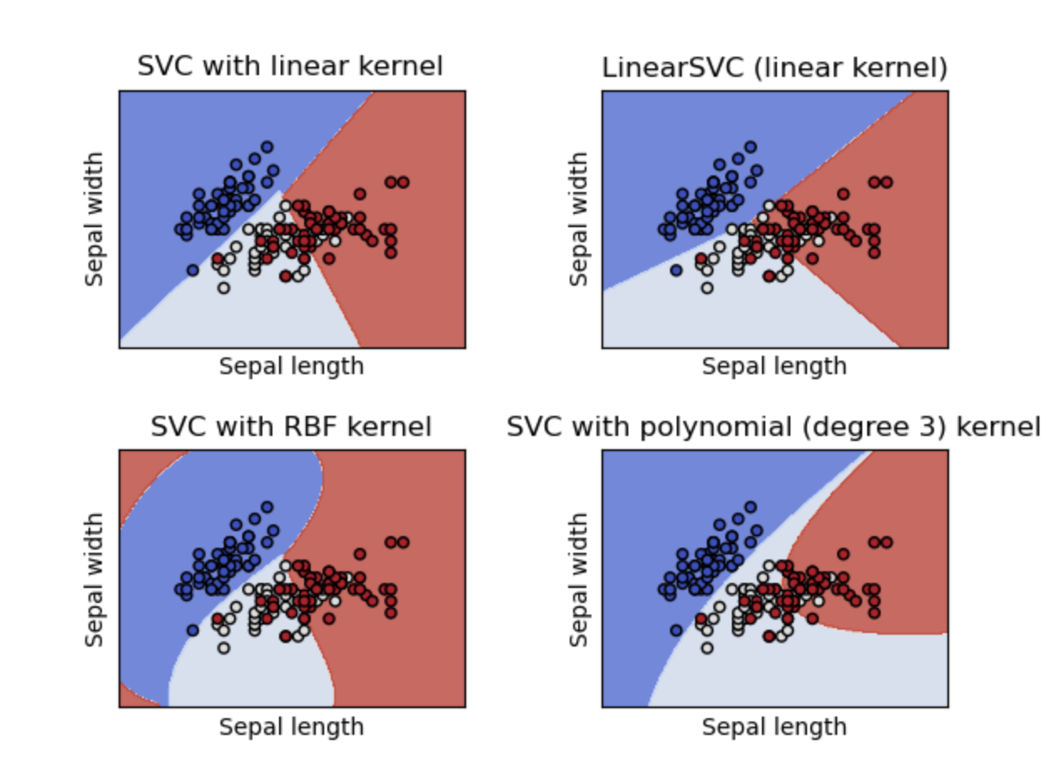
SVM Algorithm (Concept)
What is SVM Kernel?
Kernel: Mapping function that transforms a given space into some other (usually very high dimensional space)
They can provide both linear and nonlinear model
Start with RBF since the real-world data is highly non-linear
Page 18

Slide 20
Quiz Session
Page 19

Slide 21
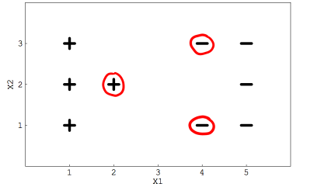
Quiz
If you remove the following any one red points from the data. Does the decision boundary will change?
Page 20

Slide 22
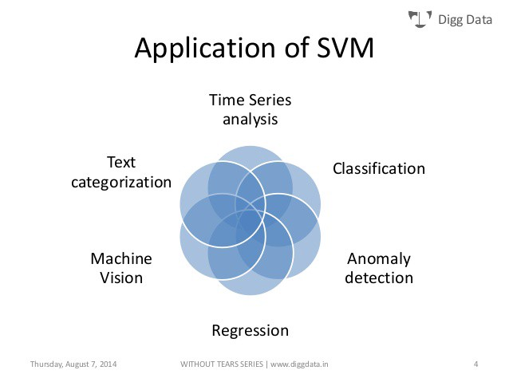
Application of SVM
Page 21

Slide 23
Terima Kasih!
Indonesia AI | AI for Everyone, AI for Indonesia
contact@aiforindonesia.org

